Slide 1
THE HUNGER GAMES
By Suzanne Collins

Slide 2
Our LEARNING OBJECTIVES: Explore the conventions of dystopian fiction Differentiate between a dystopian and utopian and society
OUR SUCCESS CRITERIA:
IDENTIFY THE FEATURES OF DYSTOPIAN SOCIETIES BY LOOKING AT OTHER SIMILAR TEXTS
DESCRIBE A TYPICAL DYSTOPIAN CHARACTER

Slide 3
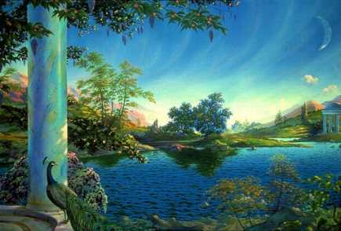
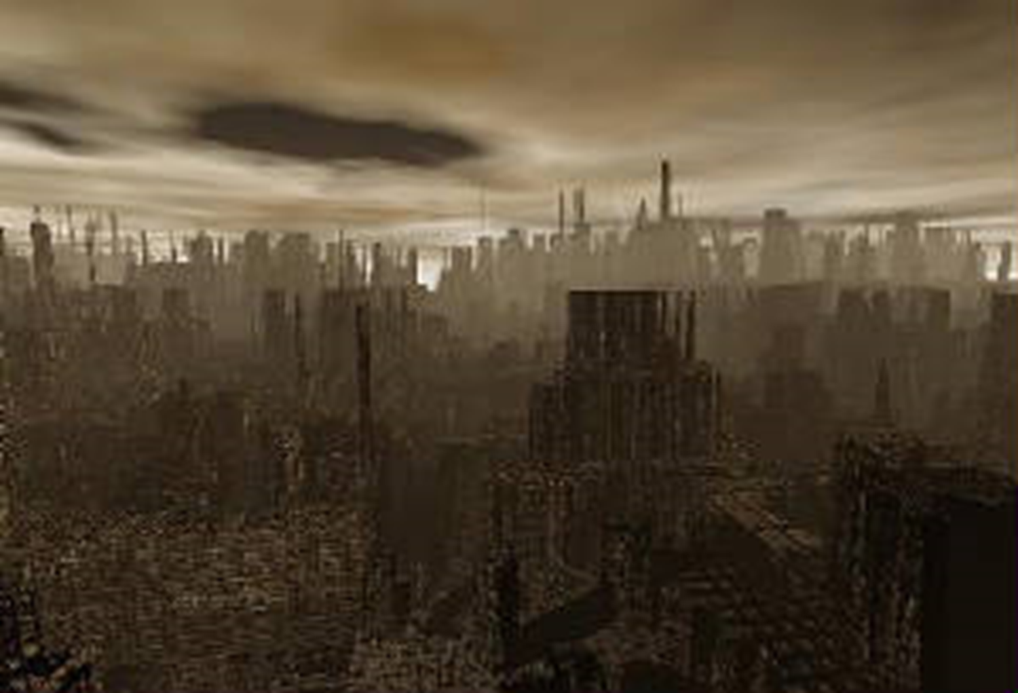
Utopia vs dystopia
What differentiate these two pictures? – Think Pair Share

Slide 4
Watch these couple of plot summaries of two famous dystopian novels by George orwell
1984
https://www.youtube.com/watch?v=h9JIKngJnCU
ANIMAL FARM
https://study.com/academy/lesson/animal-farm-plot-summary.html

Slide 5
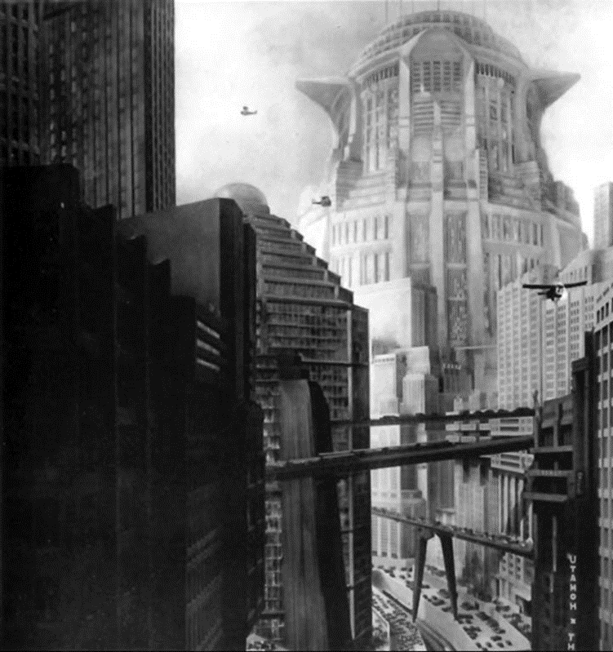





Whilst you are watching, make some notes on what you think the key conventions of dystopian fiction are.

Slide 6
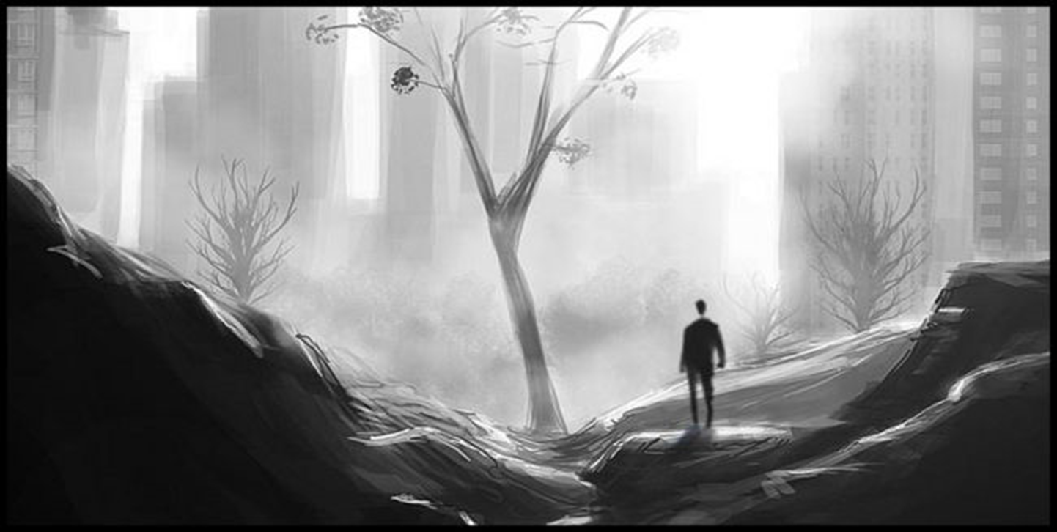
What are the key conventions of Dystopian Fiction?
Your challenge is to use the information you have gathered to write a summary of the key conventions of the genre – in no more than 100 words.

Slide 7
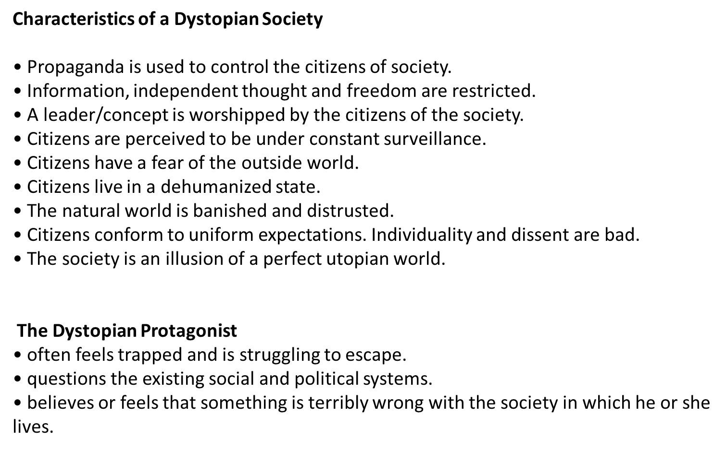


Slide 8
DEFINITIONS
Dystopian fiction: a work of fiction describing an imaginary place where life is extremely bad because of deprivation or oppression or terror
Post-Apocalyptic fiction: a work of fiction set in a world or civilization after a potentially existential catastrophe or disaster

